Slide 1




NEXT GEN EMPLOYABILITY PROGRAM
Creating a future-ready workforce
Team Members
College Name
Student Name : Balamurugan P M
Student ID : 623521104005
AVS College of Technology

Slide 2

CAPSTONE PROJECT SHOWCASE
Project Title
Building Bus Reservation System using Python and Django
Abstract | Problem Statement | Project Overview | Proposed Solution | Technology Used | Modelling & Results | Conclusion

Slide 3
Abstract
The Bus Reservation System Website helps people book bus tickets online easily.
It's made using Django, HTML, CSS, and SQLite, making it simple to use.
You can look for buses by where you want to go, when you want to leave, and what type of bus you prefer.
When you find the right bus, you can choose how many seats you need and book them.
If your plans change, you can also cancel your booking easily.
Source :

Slide 4
Problem Statement
In today's busy world, buying bus tickets can be hard and take a lot of time. The old way of getting tickets usually means waiting in long lines, filling out forms by hand, and it's not always easy to find a place to do it. Plus, there's no one place where you can easily book and handle all your bus tickets, which causes problems for both the people buying tickets and the companies running the buses.
Waiting in Queue
Inconvenience
Limited Accessibility
Manual Processes
Security Concerns
Source :

Slide 5
Project Overview
To address these challenges, there is a need for a comprehensive and user-friendly Bus Reservation System Website. This system should provide a seamless online platform for customers to search, book, and manage bus tickets conveniently.
Develop the system using modern technologies like Django, HTML, CSS, and SQLite. This makes it possible to create a website that's easy to use, reliable, and secure.
It'll be more convenient, faster, and safer for everyone involved.
Source :

Slide 6
Proposed Solution
User Registration and Authentication
Friendly User Interface
Bus Search and Booking
Cancellation
Real-time Information Updates
Accessibility
Seat Selection
Booking Confirmation
Source :

Slide 7


Technology Used
Front-end
Back-end
Source :

Slide 8
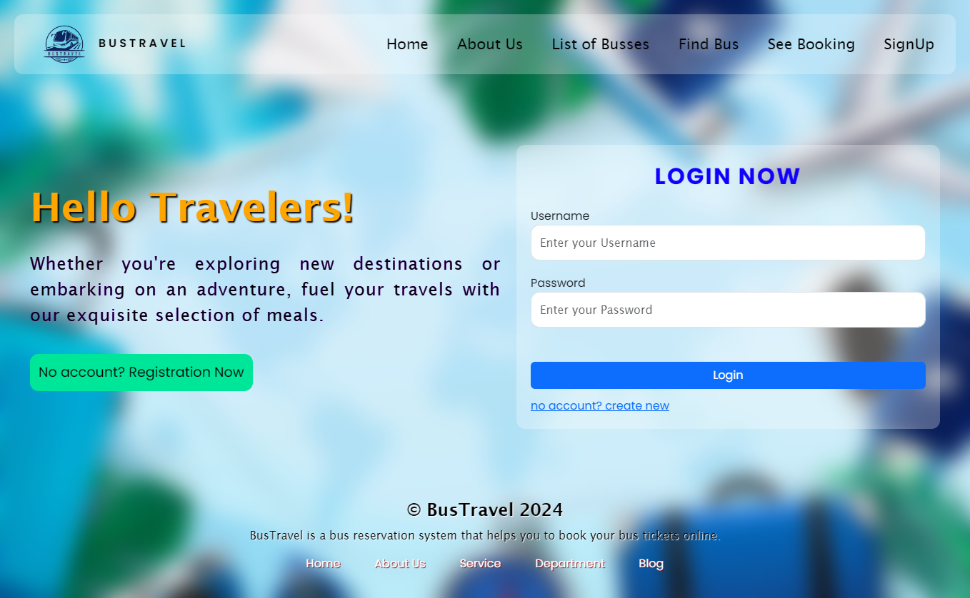
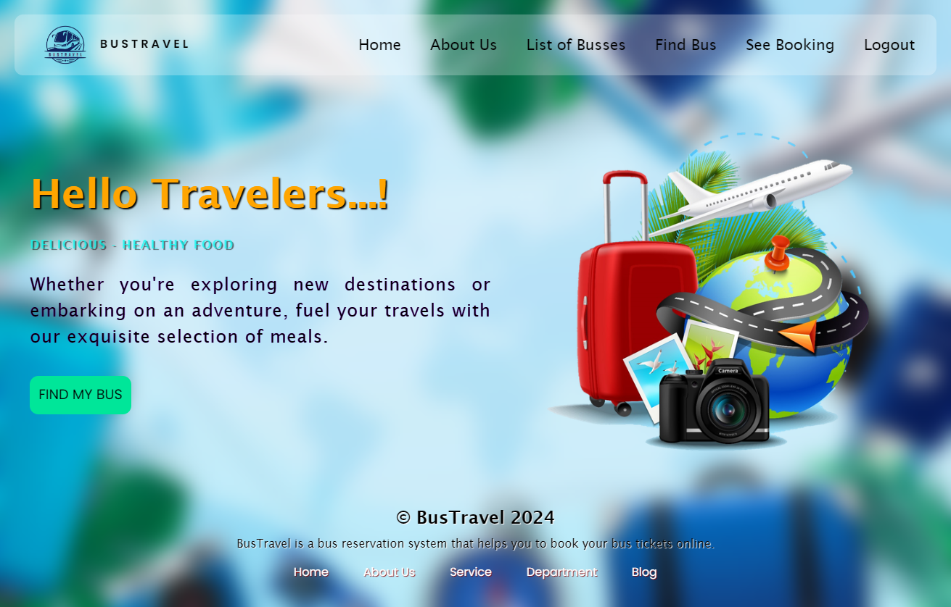
Modelling & Results
Landing page with login form
Home Page
Source :

Slide 9
Homepage

Slide 10
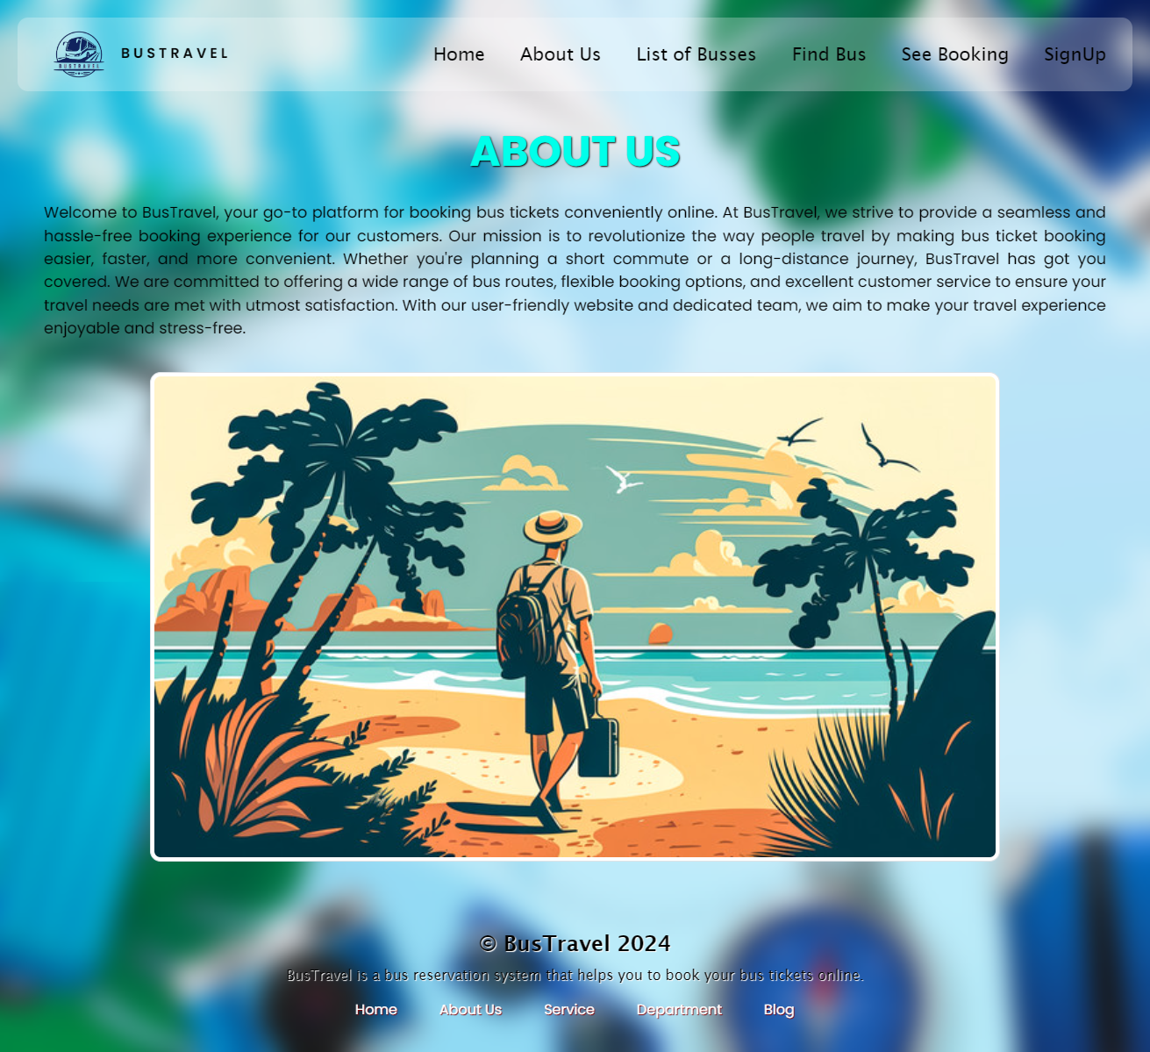
About-Us-Page

Slide 11
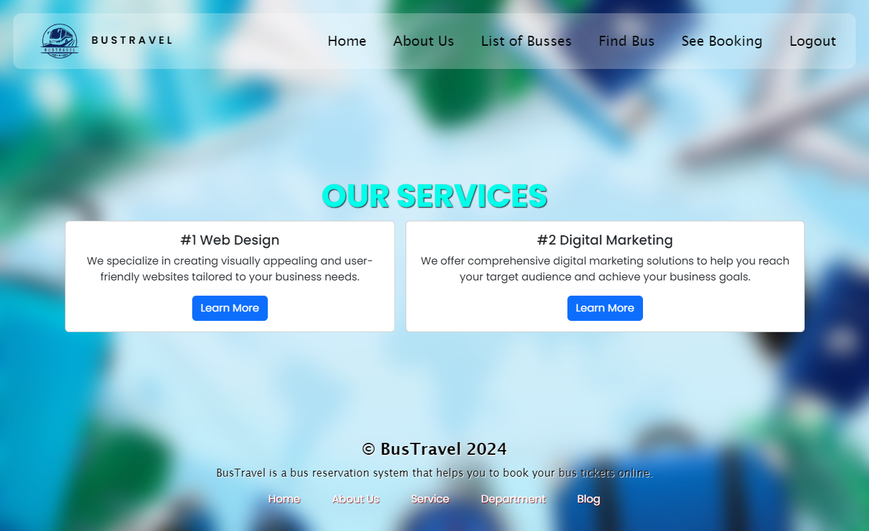
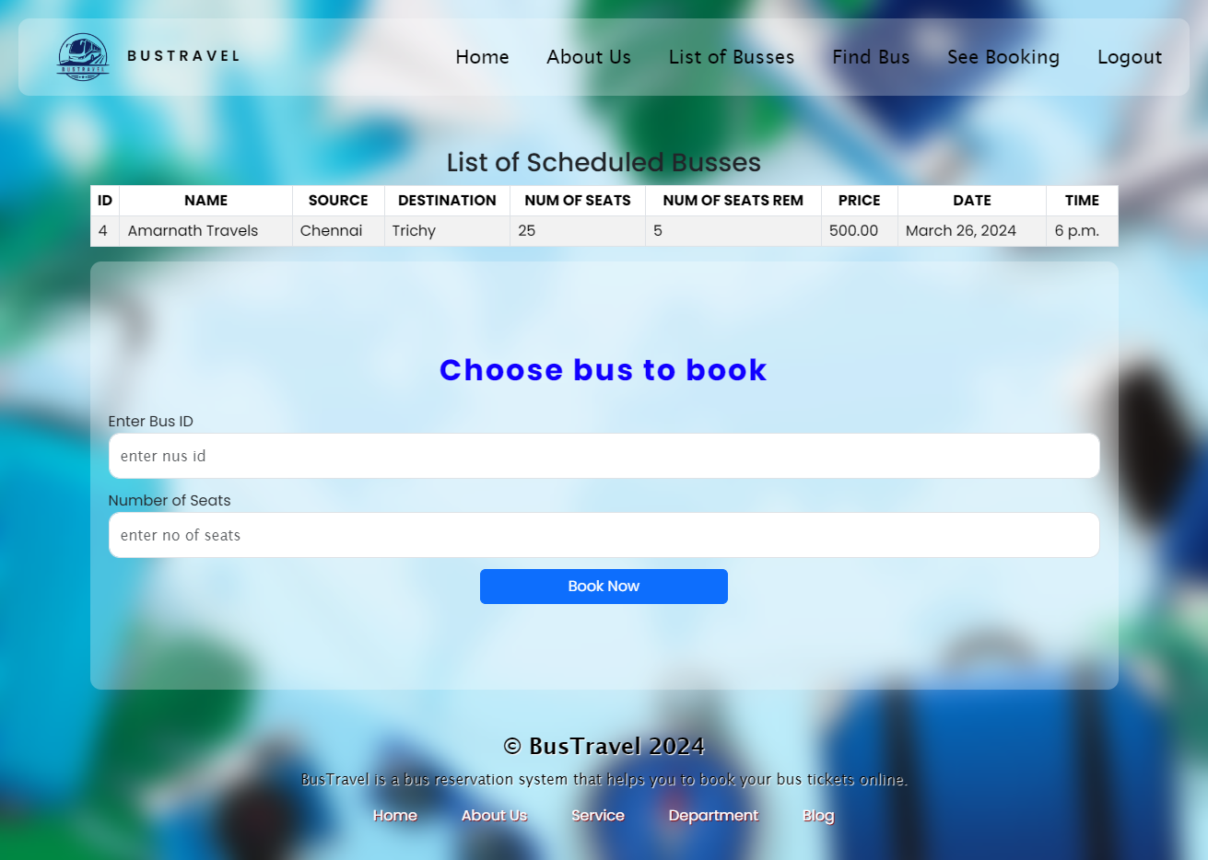
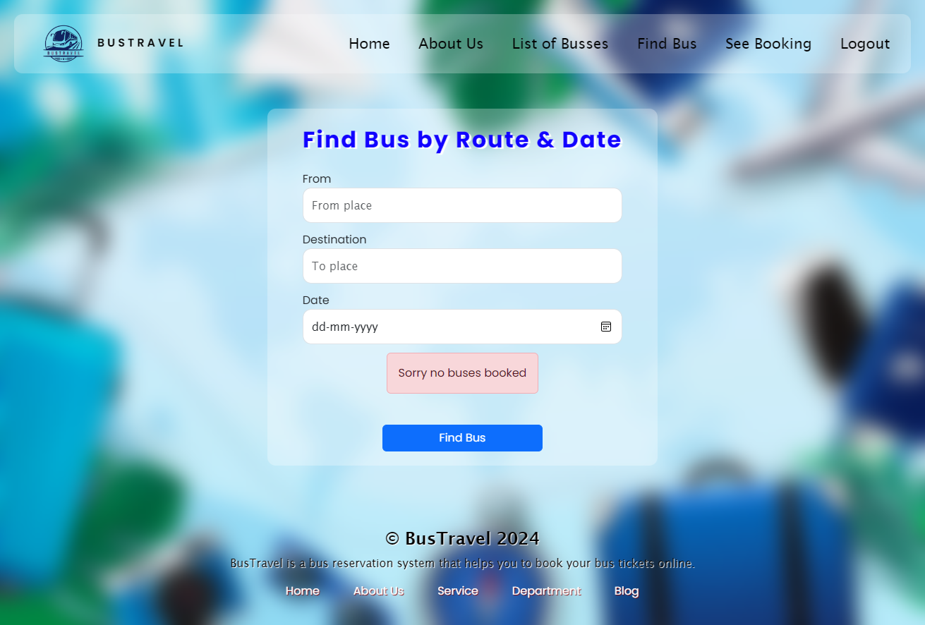
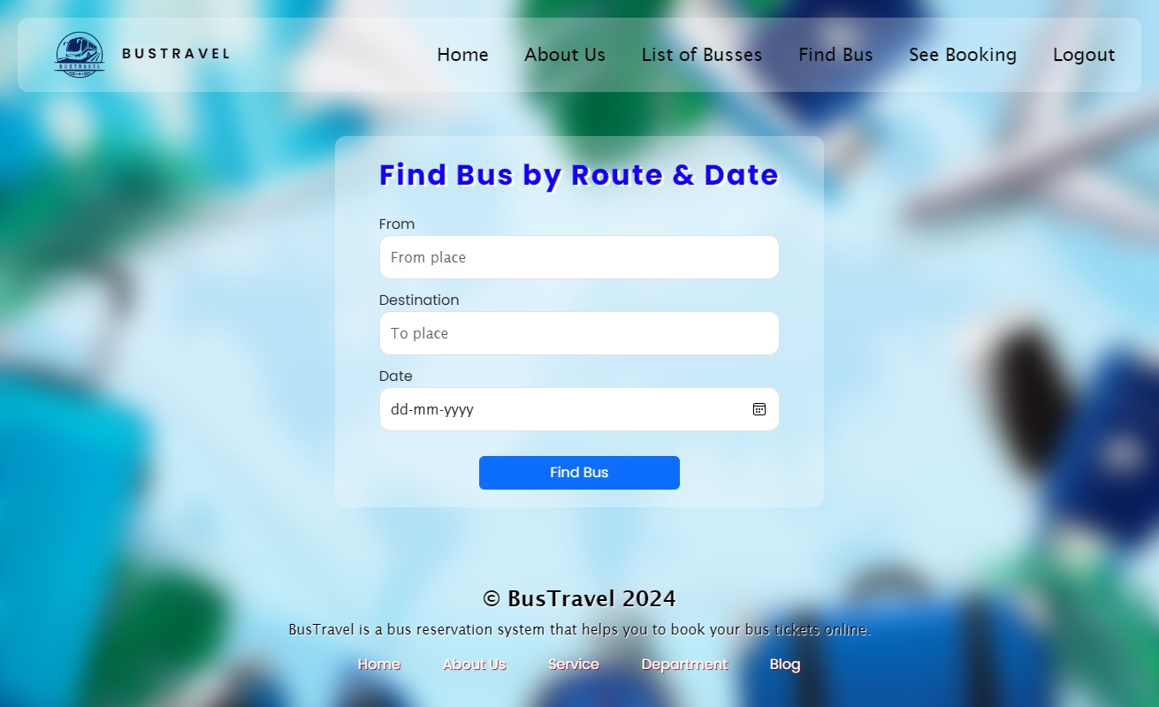
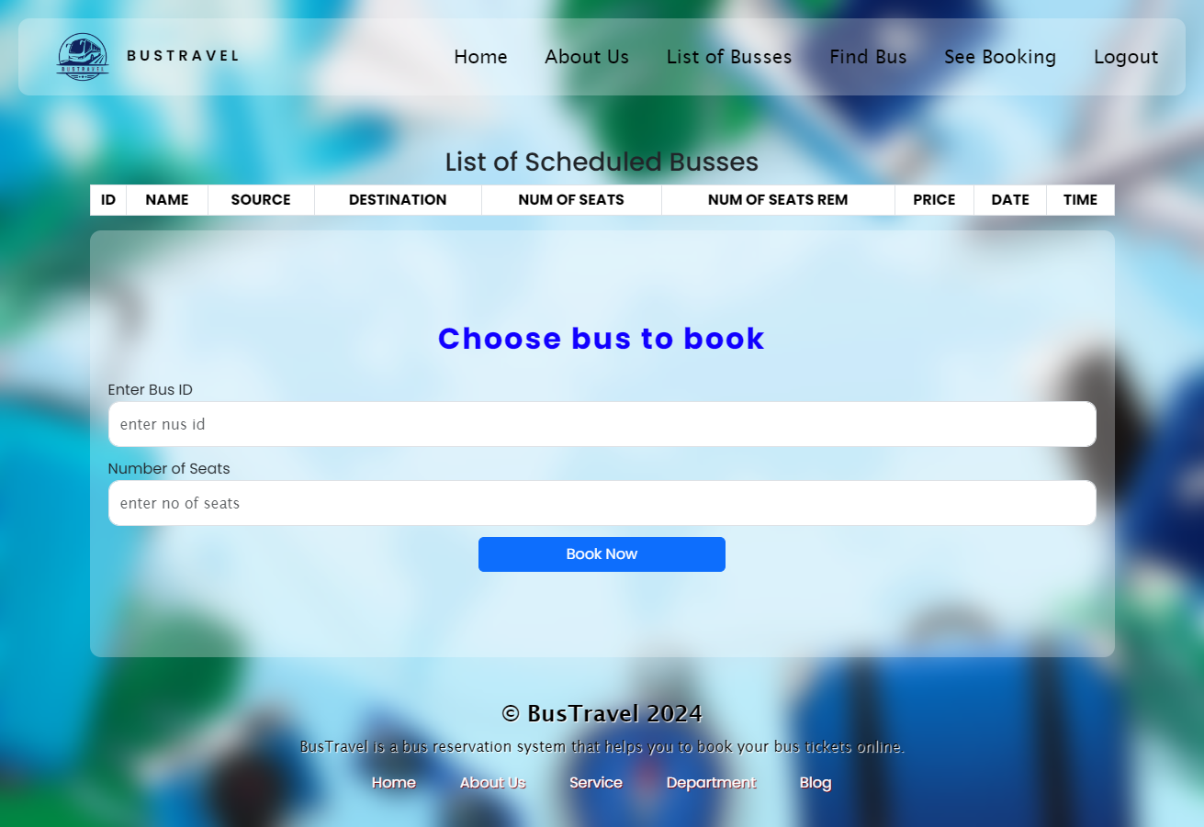
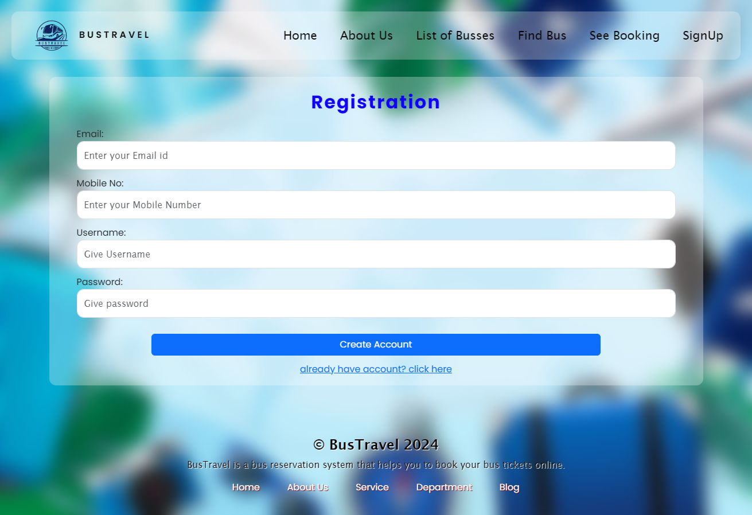
Service-Page
Our services page
Choose busses in list
See booking by route & date
Find Busses by route & date
List of Buss available
Registration

Slide 12
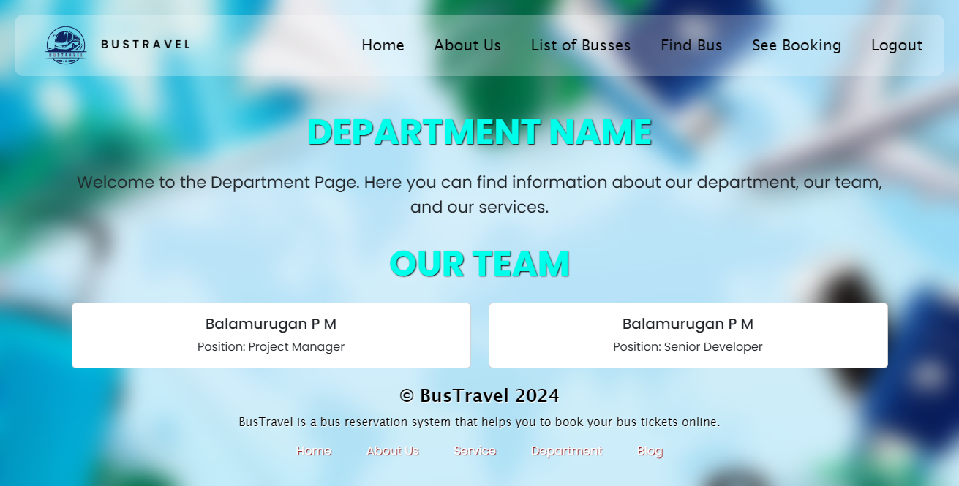
Departments-Page
Department Page
Login Page

Slide 13
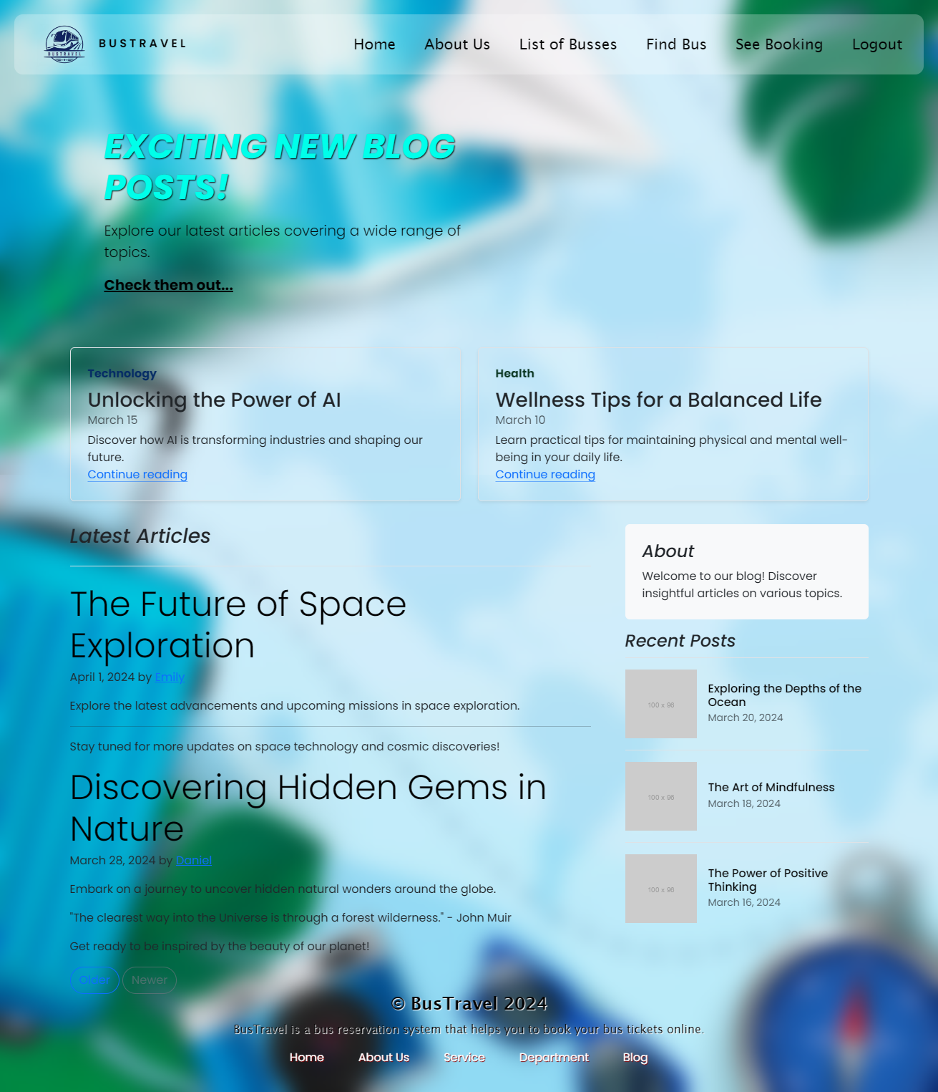
Blog-Page

Slide 14
Future Enhancements:
Mobile App Integration
Dynamic Pricing Strategies
Voice Assistants Integration
Augmented Reality (AR) Seat Selection
Intelligent Routing and Optimization
Secure Payment Options
Administrative Tools
Language Translation Services
Smart Ticket Verification
Compliance raise system

Slide 15
Conclusion
In conclusion, the development of a Bus Reservation System Website presents a significant opportunity to address the challenges and inefficiencies associated with traditional bus ticket booking methods.
Our Bus Reservation System Website is poised to transform the way bus tickets are booked and managed, offering a seamless and efficient booking experience while improving accessibility, convenience, and security.
With continuous improvement and innovation, we are committed to delivering a best-in-class solution that meets the evolving needs of users and bus operators in the transportation industry.
Source :

Slide 16
Thank You!
Notes:
Thank You !!

